Slide 1
MY AUTOBIOGRAPY
A JOUNEY THROUGH LIFE
KINYANJUI WANJIRU C027-01--0808/2020

Slide 2
INTRODUCTION
Introduction: My Life Journey - A Story of Faith, Family, and Growth
Purpose of the Presentation: Today, I am delighted to share with you my autobiography, a journey that encompasses my formative years, educational experiences, and the values that have shaped my life.
Sections and Themes:
Early Years: My humble beginnings and harmonious childhood.
Family and Home: A glimpse into my upbringing and the place I call home.
Primary School: My early experiences in primary school.
High School Years: My years at Ichuni Girls High School and the lessons learned.
University Journey: My pursuit of a degree in Business Information Technology at Dedan Kimathi University of Technology.
Faith and Community Service: My involvement in the Catholic faith and community service.
Childhood Memories: Cherished moments and experiences from my early years.

Slide 3
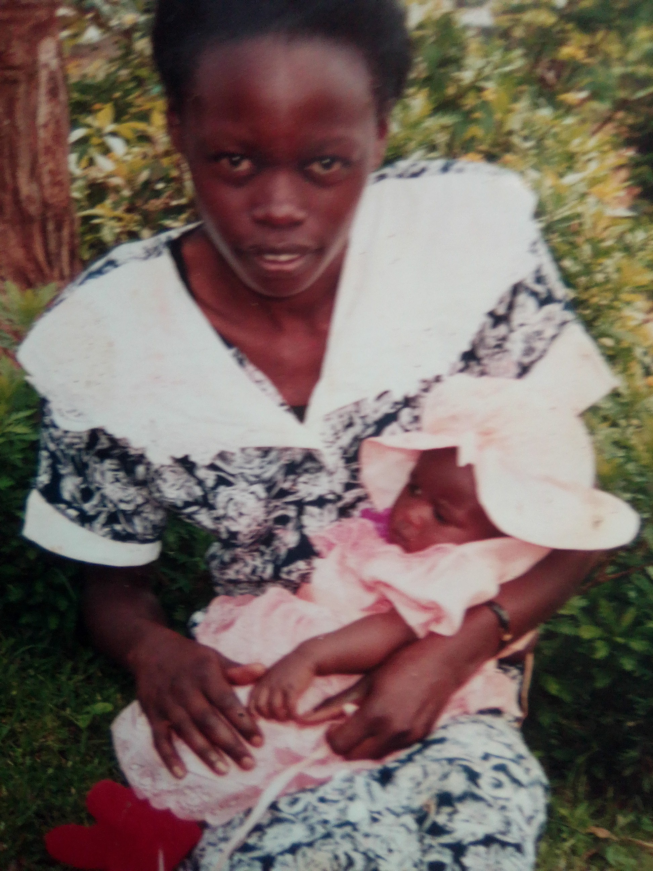
EARLY YEARS.
Birthplace and Childhood:
I was born in Ichuni-Keroka(Bosigisa) a small and close-knit village where my journey began.
My childhood was marked by the simplicity of village life, where values like unity, togetherness, and community held great significance.

Slide 4
FAMILY AND HOME
My Family:
I was blessed to be born into a loving family. My family consisted of 5 members who played unique roles in my upbringing.
Roles within the Family:
Father(Joseph Nyakundi): He is the head of our family, our role model and sense of inspiration
Mother(Rhoda Bonareri):She is our guiding light and sense of reason
I (Monicah kerubo):Firstborn
Emmanuel Mosomi: Second born
Robert Mokua: Lastborn
The Place I Grew Up:
My childhood home was situated in Ichuni, a peaceful village characterized by hills, lush greenery and open fields.

Slide 5
PRIMARY SCHOOL
Experiences in Primary School:
My primary school years were marked by learning, play, friendships.
Memorable Teachers:
Among the educators who left a lasting impression, one of the most memorable was Mrs . Zipporah Ongaga. She was my lower primary teacher who was so motherly and kind and also ready to help me with my studies. This involvement of hers really boosted my grades.
Friendships:
I forged lifelong friendships during my primary school years. Some of my closest friends were Mary, Sharon and Agnes We shared countless adventures and experiences like group discussion, playing and sharing lunch.

Slide 6
HIGH SCHOOL YEARS
My Time at Ichuni Girls High School:
My journey continued into my high school years at Ichuni Girls High School, a place that holds a special place in my heart.
Experiences and Memories:
I experienced a diverse range of experiences during my high school years, from academic achievements to extracurricular activities.
Moments like educational trips, parents visiting days, entertainment times and Holy Mass sessions are memories etched in my mind and fulfilling.

Slide 7
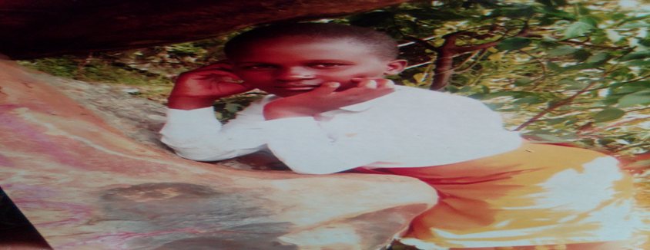

Slide 8
ACADEMIC ACHIEVEMENTS.
High School Success:
My high school journey was marked by dedication and a strong commitment to academics.
Academic Achievements:
During my time at Ichuni Girls High School, I was honoured to achieve top student awards in subjects like History, English and Kiswahili
I also participated in academic competitions like Science contest and Debates.

Slide 9
PERSONAL GROWTH
Shaping My Character:
My high school years at Ichuni Girls High School were transformative in many ways, playing a crucial role in shaping my character and outlook on life.
What I Learned:
I learnt values like intergrity, cooperation, discipline, maintaining a positive attitude at all times, being ready to learn.
My principal used to tell us that our own lives were in our own hands and so it was up to us to either make it or break it.

Slide 10
SECONDARY SCHOOL EXPERIENCES
Diving into the World of Secondary School:
My transition to secondary school was a significant step in my educational journey, where I encountered a world of opportunities and experiences.
Academic Pursuits:
At Ichuni Girls High School, I pursued a rigorous academic curriculum that included subjects like Mathematics, English, Kiswahili, Biology and Chemistry. I was determined to excel academically and devoted countless hours to my studies.
Extracurricular Involvement:
Beyond academics, I actively participated in various extracurricular activities such as athletics, Badminton and the Health Club.

Slide 11
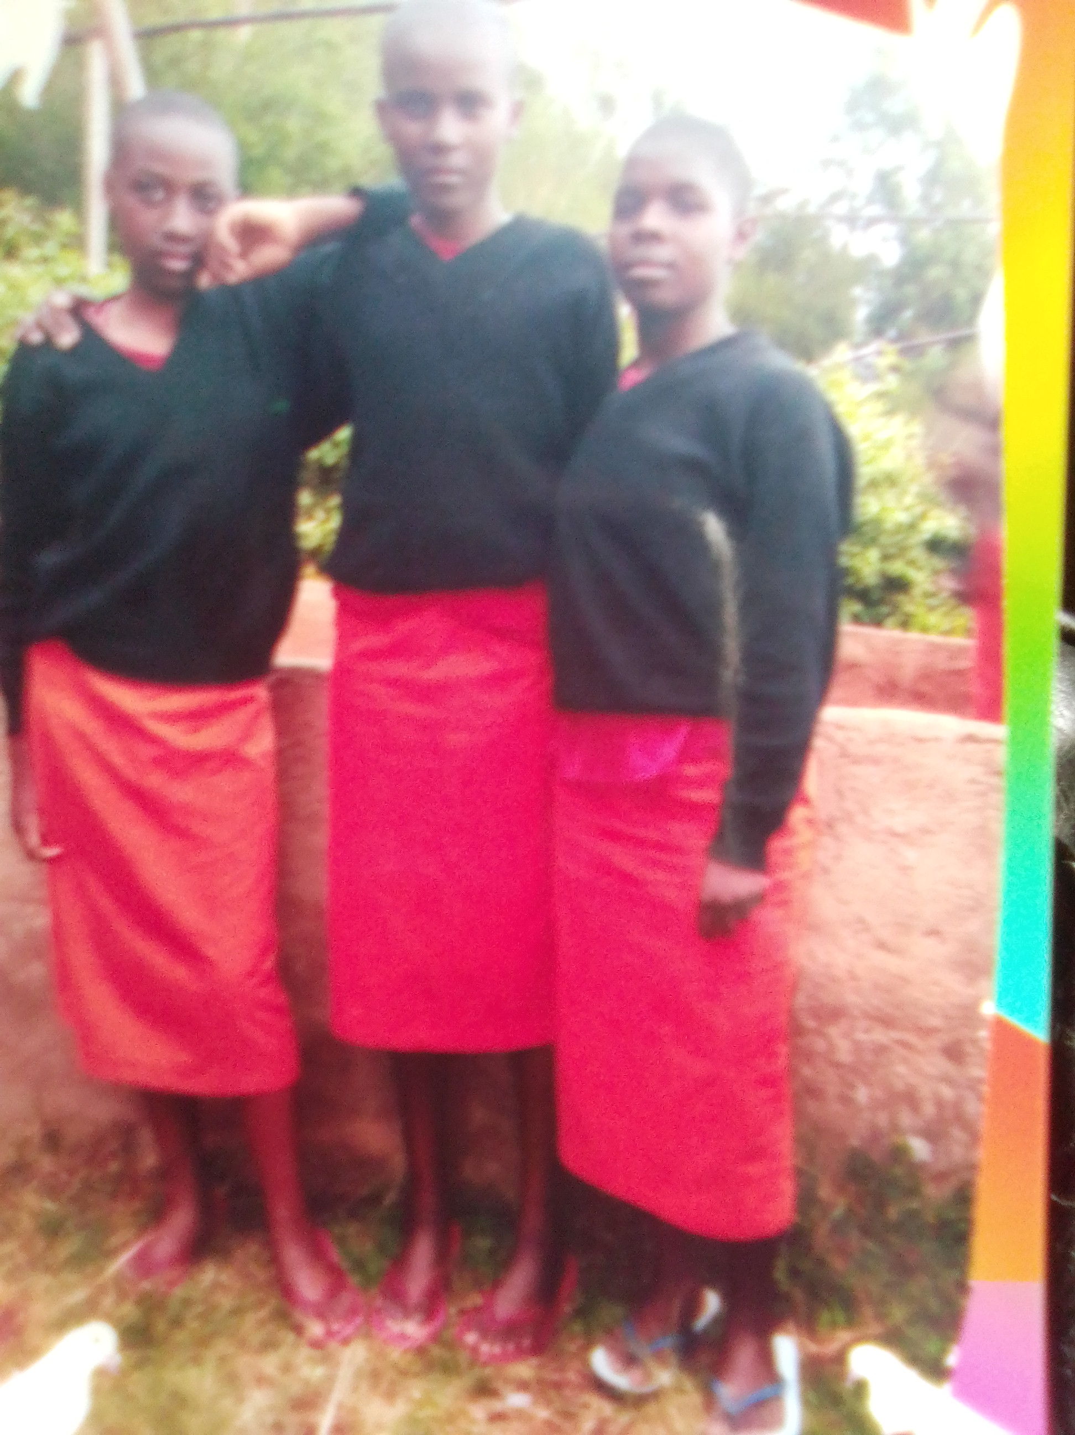
MEMORIES WITH FRIENDS
High School Bonds:
High school is not just a place of learning but also a time of building lasting friendships. My years at Ichuni Girls High School were filled with unforgettable moments with friends.
Memorable Moments:
I shared numerous memorable moments with friends during specific events or activities, e.g., school trips, talent shows, sports events, prize-giving ceremonies.

Slide 12
UNIVERSITY JOURNEY
.
Higher Education Adventures:My time at Dedan Kimathi University of Technology was a journey of higher education, where I pursued my degree in Business Information Technology and explored new horizons.
It was a time of personal and academic growth as I navigated the challenges and opportunities presented by this esteemed institution

Slide 13
INVOLVEMENT IN FAITH AND COMMUNITY SERVICE
Deepening My Faith:
My university journey provided an opportunity for me to deepen my commitment to the Catholic faith. It was a time of spiritual growth and reflection.
Community Service and Outreach:
During my time at Dedan Kimathi University of Technology, I actively engaged in various community service and outreach programs.
I participated in visiting the sick, elderly and children’s home to give hope to the hopeless.

Slide 14
Personal GROWTH AND ASPIRATIONS
Shaping My Future:
My life's journey, from early years to higher education, has profoundly shaped my personal growth and aspirations.
Aspirations for the Future:
Looking ahead, I aspire to take full control of my life after being independent , become a senior software engineer, gain more knowledge in my career field and enrich my faith.
My experiences have instilled in me the determination and values to strive for honesty, hard work and humility

Slide 15
CHILDHOOD MEMORIES
Early Years and Playful Days:Reflecting on my early years, I'm transported back to a time of innocence, laughter, and cherished moments.
A HARMONIOUS CHILDHOOD
My early years were characterized by a harmonious upbringing, rich in the bonds of family, friendships, and a strong sense of community. I grew up in a close-knit village, where life was simple, and the values of unity and togetherness were deeply ingrained.
I was fortunate to have cousins and childhood friends as neighbors. We shared a unique camaraderie that added a special dimension to my upbringing. Together, we explored the village, climbed trees, played games in open fields, and embarked on countless adventures. Our friendships were forged in the laughter and joy of carefree days, forming bonds that would last a lifetime.

Slide 16
CONCLUSION
A Life Journey in Reflection:
My life journey, as I've shared with you today, is a tapestry of experiences, growth, and cherished memories.
Lessons Learned:
Throughout this journey, I've learned the value of integrity, honesty, hard work and humility and these insights continue to guide my path.
Impact of Experiences:
The impact of these experiences is profound, influencing who I am today and shaping my aspirations for the future.
Gratitude:
I am deeply grateful for the support, love, and opportunities that have been bestowed upon me by my family, friends, teachers, and mentors.
The Journey Continues:
As I move forward, I carry with me the knowledge that my journey is ongoing, filled with the aspiration to make a positive impact on the world, both professionally and through acts of kindness and service.

Slide 17
QUESTIONS???

Slide 18
THANK YOU

